Slide 1
WELCOME

Slide 2

CONTENTS
INTRODUCTION
OBJECTIVES
METHODOLOGY
FUTURE SCOPE

Slide 3

CONTENTS
INTRODUCTION
OBJECTIVES
METHODOLOGY
FUTURE SCOPE

Slide 4
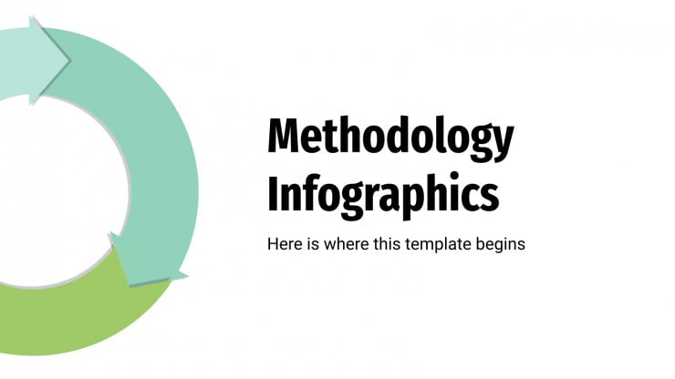
CONTENTS
INTRODUCTION
OBJECTIVES
METHODOLOGY
FUTURE SCOPE

Slide 5

CONTENTS
INTRODUCTION
OBJECTIVES
METHODOLOGY
FUTURE SCOPE

Slide 6
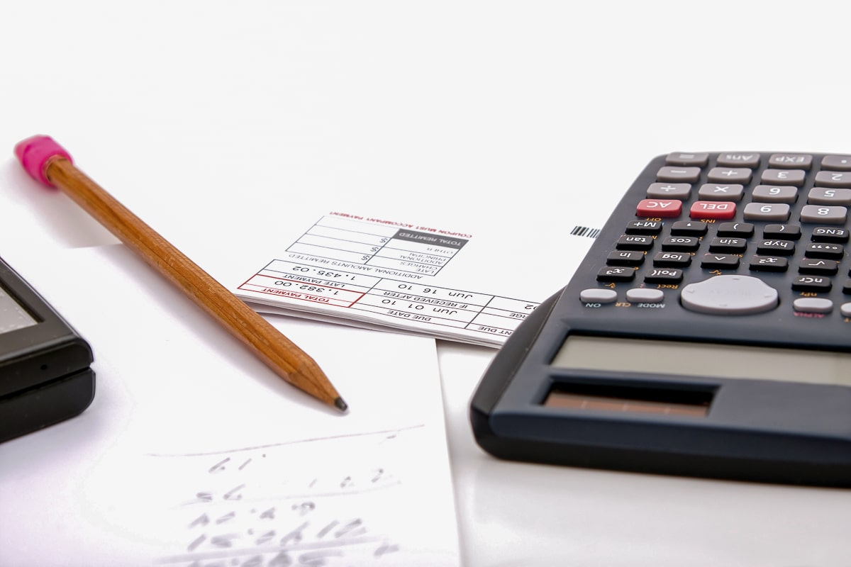
Expense Tracking and Budgeting using Expense Tracker

Slide 7

Developed by:- Abhi Gupta
Omkar Katore
Project Guide:- Dr . Kamlesh Meshram Sir
Presentation by:- Abhi Gupta

Slide 8

In today's fast-paced world, managing personal finances is crucial for maintaining financial stability. Keeping track of daily expenses can help individuals gain better control over their spending habits, plan budgets effectively, and make informed financial decisions. However, manually recording expenses can be time-consuming and prone to errors, leading to inefficient tracking and unorganized financial records.
This project aims to develop a Daily Expense Tracker using Python, designed to automate and simplify the process of recording and managing personal expenses.
The application will allow users to log their daily expenditures, categorize them, and visualize their spending patterns through interactive charts and summaries.
By providing a clear overview of where the user's money is being spent, this tool will assist in better financial planning and budgeting.
INTRODUCTION

Slide 9
OBJECTIVES
Automate Expense Tracking
Develop a Python-based tool that allows users to efficiently log and track daily expenses, reducing the manual effort required to maintain personal financial records.
Provide Real-Time Expense Visualization
Implement dynamic pie charts and other visual aids to give users a clear, real-time representation of their spending patterns across different categories, aiding in better financial insights.
Enable Budget Monitoring
Allow users to set a budget limit and track their current spending relative to that limit, ensuring that they are alerted if they approach or exceed their budget.
Ensure Flexibility and Customization
Allow users to customize categories, update or delete expense entries, and view expense summaries over specific time periods to tailor the tracker to their personal financial needs.

Slide 10
METHODOLOGY
Approach
Tools
Techniques
Technology

Slide 11
METHODOLOGY
Requirement Analysis:
Identify key features: expense logging, categorization, budget setting, and data visualization.
Design Phase:
Plan data storage in SQLite for expense details.
Design a modern UI for easy input and data display.
Plan dynamic charts for visualizing expenses.
Development Phase:
Build UI using Python libraries of Tkinter.
Implement core functions: expense entry, categorization, and budget tracking.
Store data locally for retrieval and updates.
Data Visualization:
Use libraries Matplotlib to create real-time pie charts and summaries.
Testing and Validation:
Perform unit and integration testing.
Test user experience and improve based on feedback.
Deployment and Maintenance:
Deploy the tool, provide user documentation, and ensure continuous updates based on user feedback.
Tools
Approach
Techniques
Technology

Slide 12
METHODOLOGY
Approach
Tkinter:
Tkinter is the standard Python library for creating graphical user interfaces (GUIs). It's used to build the interactive interface of the expense tracker, allowing users to input expenses, view categories, and interact with buttons, labels, and tables.
sqlite3:
sqlite3 is a lightweight, built-in database management system in Python. It’s used to store, retrieve, and manage expense records, such as date, amount, and category.
tkcalendar.DateEntry:
This is an additional widget that extends Tkinter’s capabilities, allowing users to pick dates from a calendar rather than manually entering them. It's particularly useful for selecting dates when logging or filtering expenses.
matplotlib:
matplotlib is a popular Python library used for creating data visualizations, including charts and graphs. In this project, it is used to create pie charts to visually represent how expenses are distributed across different categories.
FigureCanvasTkAgg:
This is a bridge between Matplotlib and Tkinter, allowing charts created with Matplotlib to be embedded directly into the Tkinter window.
Tools
Techniques
Technology

Slide 13
METHODOLOGY
Approach
GUI Design with Tkinter:
Purpose: Provides an intuitive and interactive way for users to manage their daily expenses.
Database Management with SQLite:
Purpose: Ensures efficient and persistent data storage, allowing the tracker to maintain expense history even after closing the app.
Data Visualization with Matplotlib:
Purpose: Helps users understand their spending patterns at a glance through graphical representations.
Dynamic Budget Tracking:
Purpose: Alerts users when their expenses approach or exceed their set budget, promoting better financial management.
Real-Time Date Selection with tkcalendar:
Purpose: Enhances user experience by simplifying date input, especially when entering or filtering expenses by date.
Embedding Charts in the GUI:
Purpose: Provides seamless integration of visual data representation into the application, keeping everything within a single window.
Tools
Techniques
Technology

Slide 14
METHODOLOGY
Python:
Core Language: Python serves as the primary programming language for developing the entire application, including the interface, database interactions, and visualizations. It offers simplicity and versatility, making it well-suited for this project.
Tkinter:
GUI Framework: Tkinter is used to create the graphical user interface (GUI) of the application, allowing users to interact with the expense tracker through buttons, forms, and visual elements.
SQLite:
Database Management: SQLite is used for local database storage, allowing the application to store and retrieve expense data such as dates, amounts, and categories in a structured format.
Matplotlib:
Data Visualization Library: Matplotlib is employed to generate visualizations, such as pie charts, to display the breakdown of expenses. This makes it easier for users to understand their spending habits.
tkcalendar:
Date Widget Library: The DateEntry widget from tkcalendar is used to allow users to pick dates from a calendar, simplifying the process of selecting dates when entering expenses.
Python's sqlite3 Module:
Database Interface: The sqlite3 module in Python is used to interact with the SQLite database, handling tasks such as inserting, querying, and updating expense data.
Matplotlib-Tkinter Integration (FigureCanvasTkAgg):
Embedding Charts in GUI: This module bridges Matplotlib and Tkinter, allowing charts to be embedded directly into the application's interface.
Approach
Tools
Technology
Techniques

Slide 15
Execution of Model

Slide 16
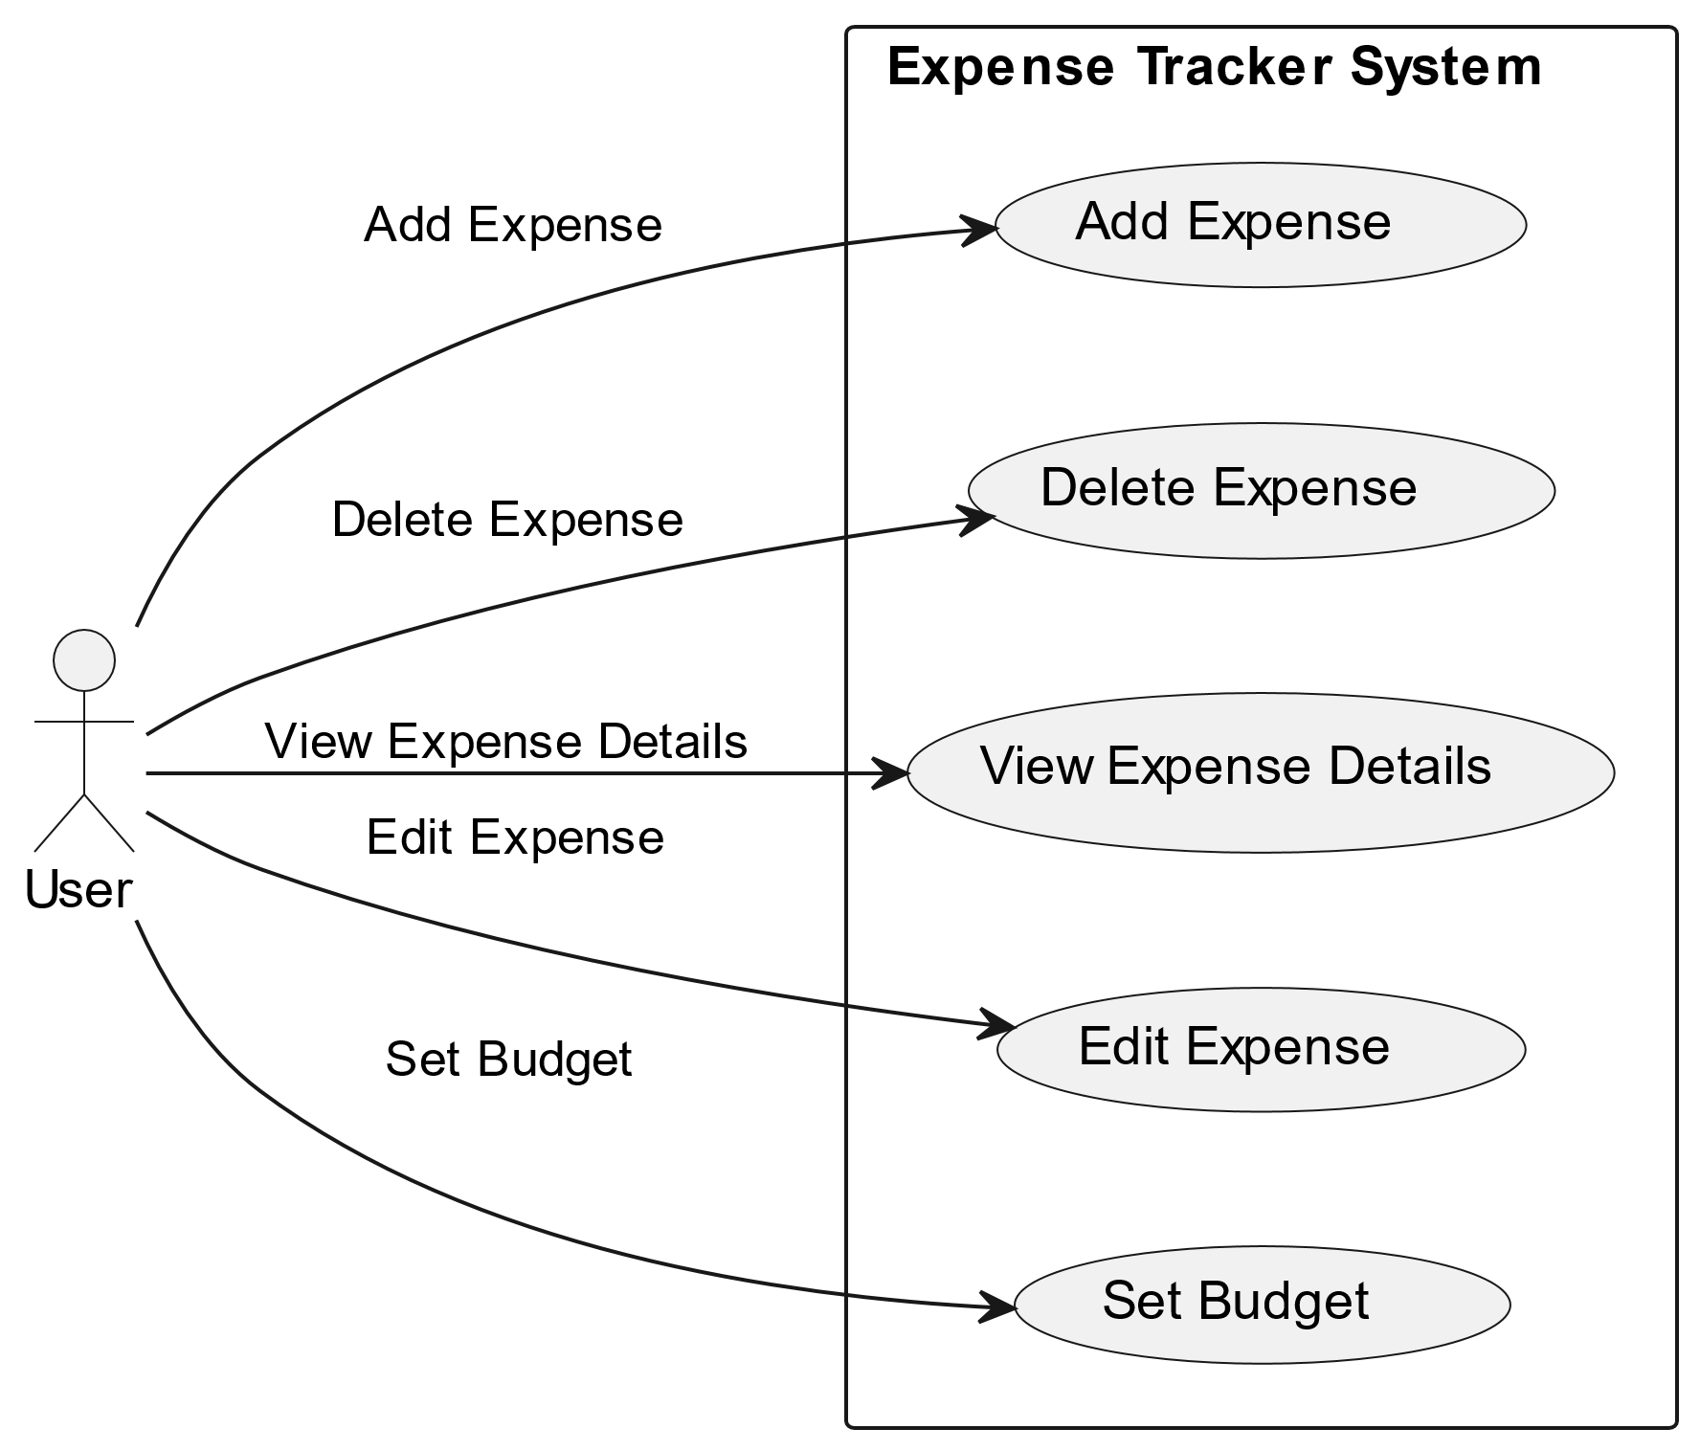
UML Diagram
ExpenseTracker
expenses: List<Expense>
addExpense(expense: Expense): void
deleteExpense(expenseId: int): void
getAllExpenses(): List<Expense>
1
contains
has
n
Expense
id: int
Budget
date: Date
amount: float
payee: String
description: String
setAmount(newAmount: float): void
amount: float
getAmount(): float
modeOfPayment: String
Use Case Diagram
Class Diagram

Slide 17
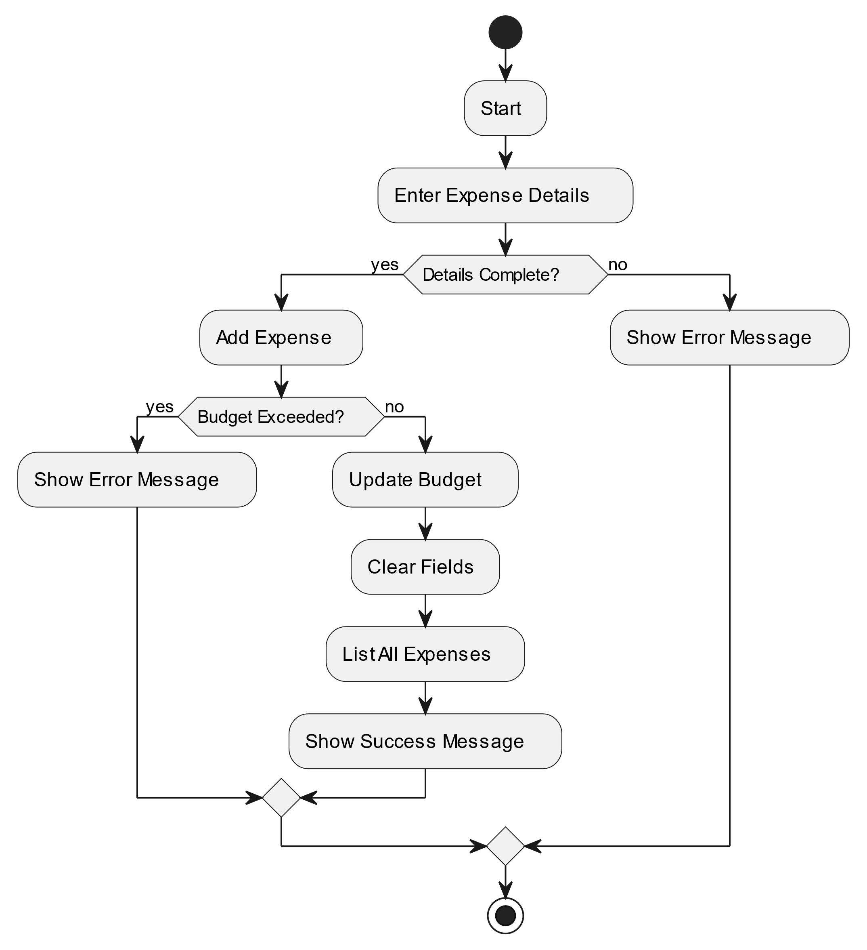
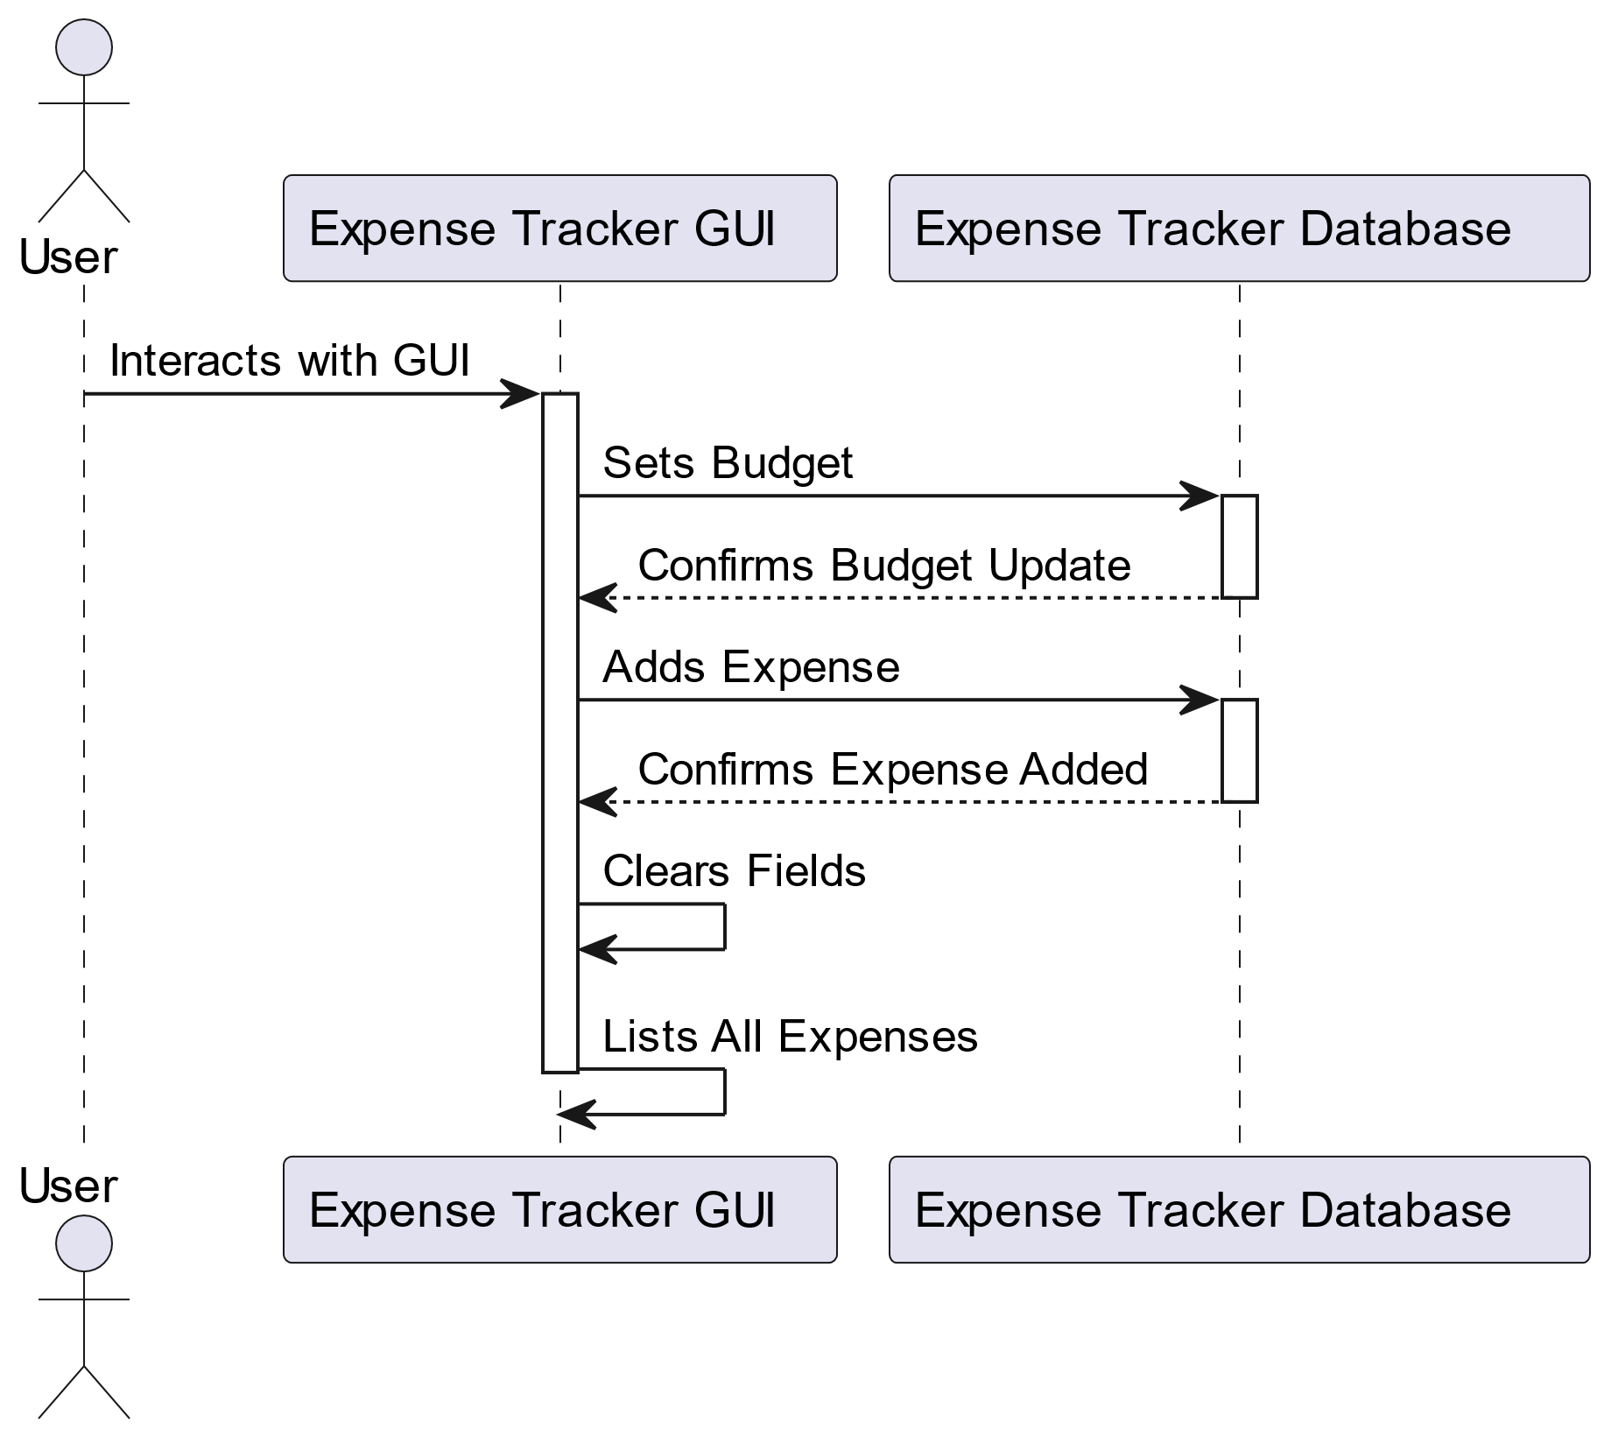
UML Diagram
Sequence Diagram
Activity Diagram

Slide 18
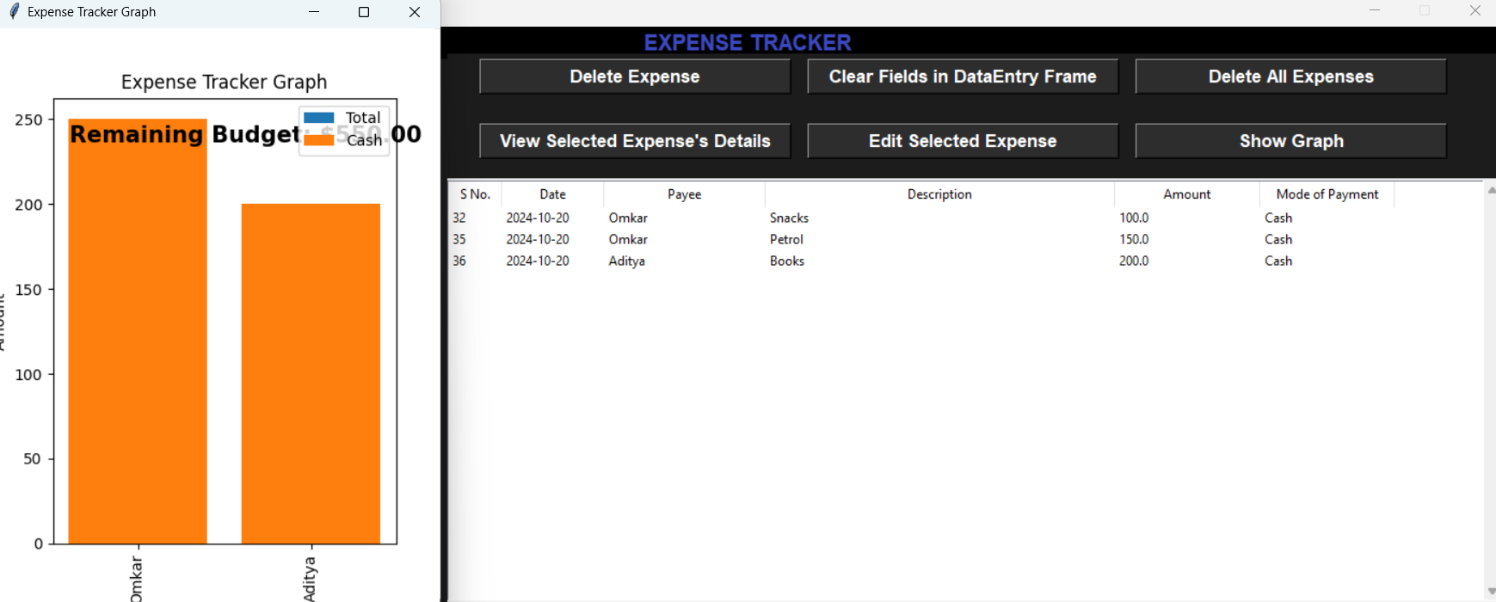
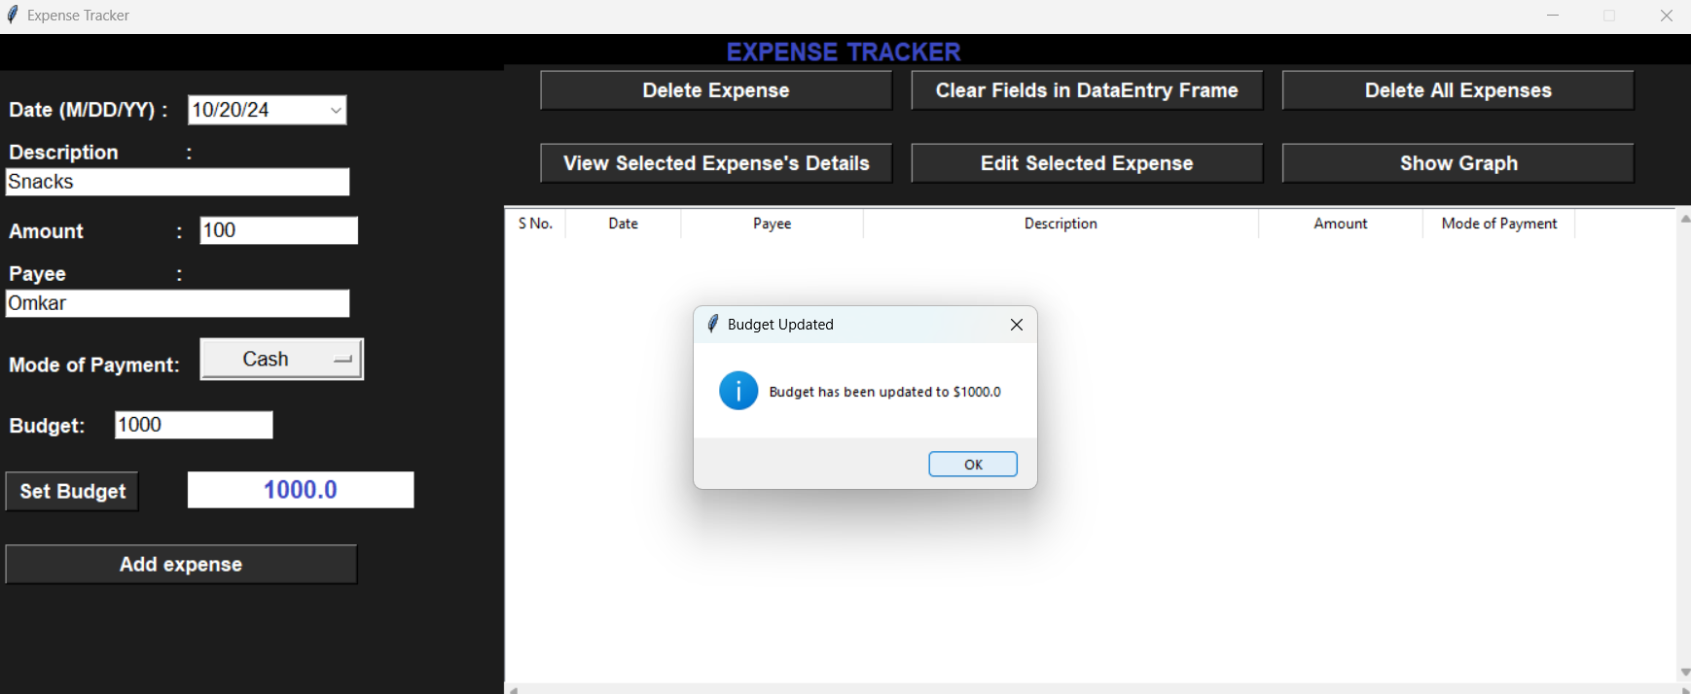
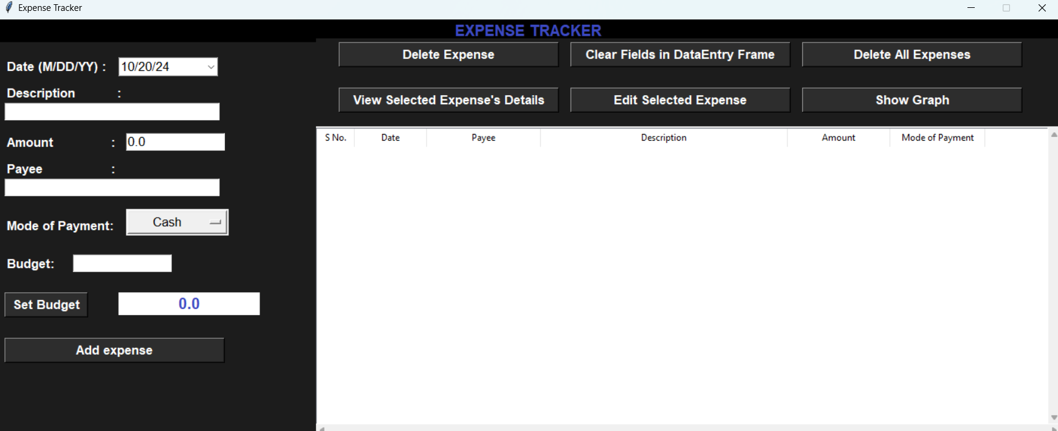
UI Images

Slide 19
Future Scope
Advanced Analytics:
Provide spending trends, category-specific insights, and personalized budget recommendations.
AI Integration:
Automate expense categorization and offer predictive spending alerts.
External Integration:
Integrate with banking services for automatic transaction imports and third-party financial tools.
Enhanced Security:
Implement encryption, two-factor authentication, and ensure data protection compliance.
Multi-Currency Support:
Support multiple currencies with automatic conversions and localization.
Collaboration Features:
Enable shared budgets, joint expense tracking, and group savings goals.
Cloud Sync:
Provide real-time sync and cloud backup for cross-device access.

Slide 20
Conclusion
Expense tracker project provides a user-friendly solution for managing personal finances, with dynamic features like real-time updates, pie chart visualizations, and budget tracking. With future enhancements like AI-powered analytics, mobile support, and external integrations, it aims to evolve into a comprehensive financial management tool, empowering users to make informed spending decisions and achieve their financial goals.

Slide 21
Thank you

